Slide 1

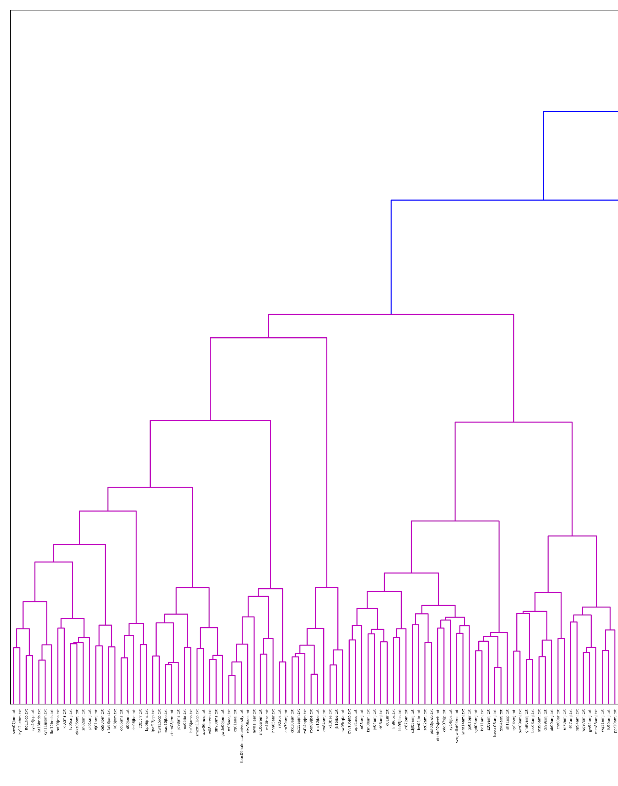
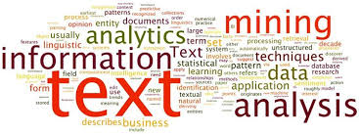
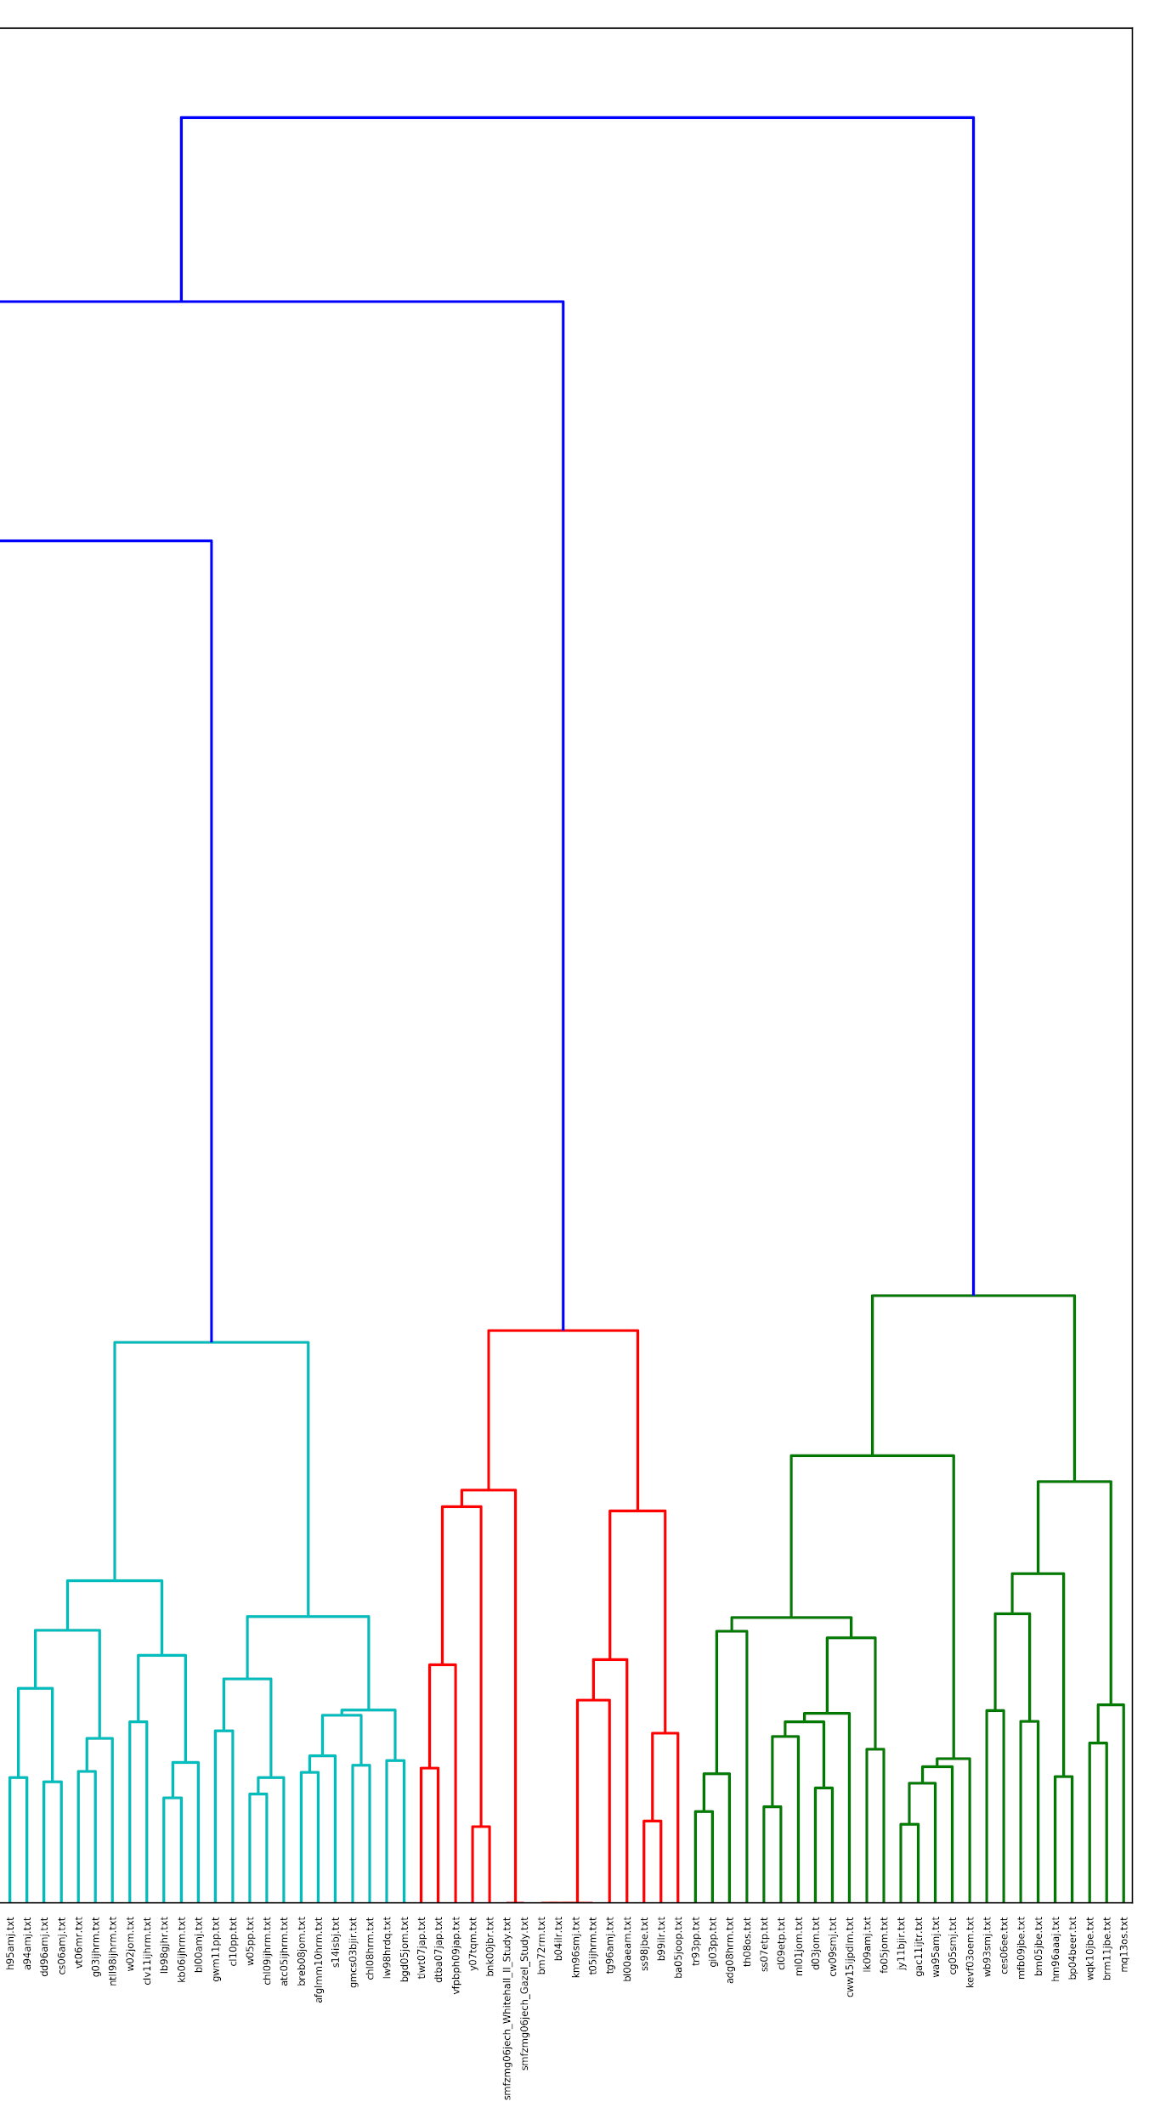
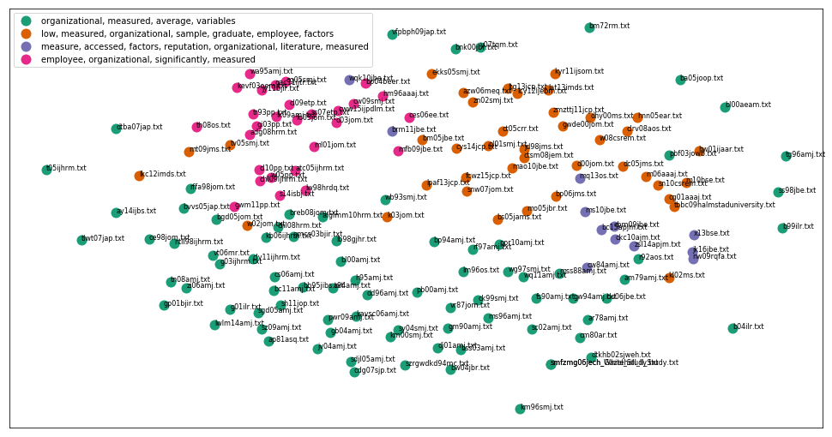
Big Data: Text Analysis for Competitive Advantage
Manoj Acharya | Jared Leach | Pratik Parekh | Sahil Sood | Amal Samirbhai Vaishnav | Nate Wilson
Objective
The goal of this project was to discover the intricacies of language processing and see how we can use the analysis from a business perspective. In this case, we posed a hypothetical and try to answer it with our algorithms.
Focus( Primary Perspective)
We approached this project from the perspective of a company attempting to utilize natural language processing to summarize and simplify for its various company documents and then specify to what groups/management within the company would use this summarization.
Summarizations are also useful for anyone who needs describers of a large number of works such as in magazine or newspaper divisions, as well as in catalog sites and online libraries.
Notes:
Something about we confirmed our cluster results with the multidimensional space graph

